Slide 1

Class 5:
Becoming More Paranoid
Cryptocurrency Cabal
cs4501 Fall 2015
David Evans and Samee Zahur
University of Virginia
Image from http://www.theregister.co.uk/2015/02/22/lenovo_superfish_removal_tool/ (but I think they stole it from Monsters and Aliens)

Slide 2
Upcoming Schedule
Today: How Cryptosystems Fail
Next Week: blockchain and mining (readings in notes)
Tuesday, 15 September: Problem Set 1
Wednesday, 23 September: Checkup 2 (delayed from 21 Sept in original schedule)

Slide 3
“Hard” Problems
Why do cryptographers consider discrete logarithm to be a hard problem?

Slide 5
Why do cryptosystems fail in practice?

Slide 6
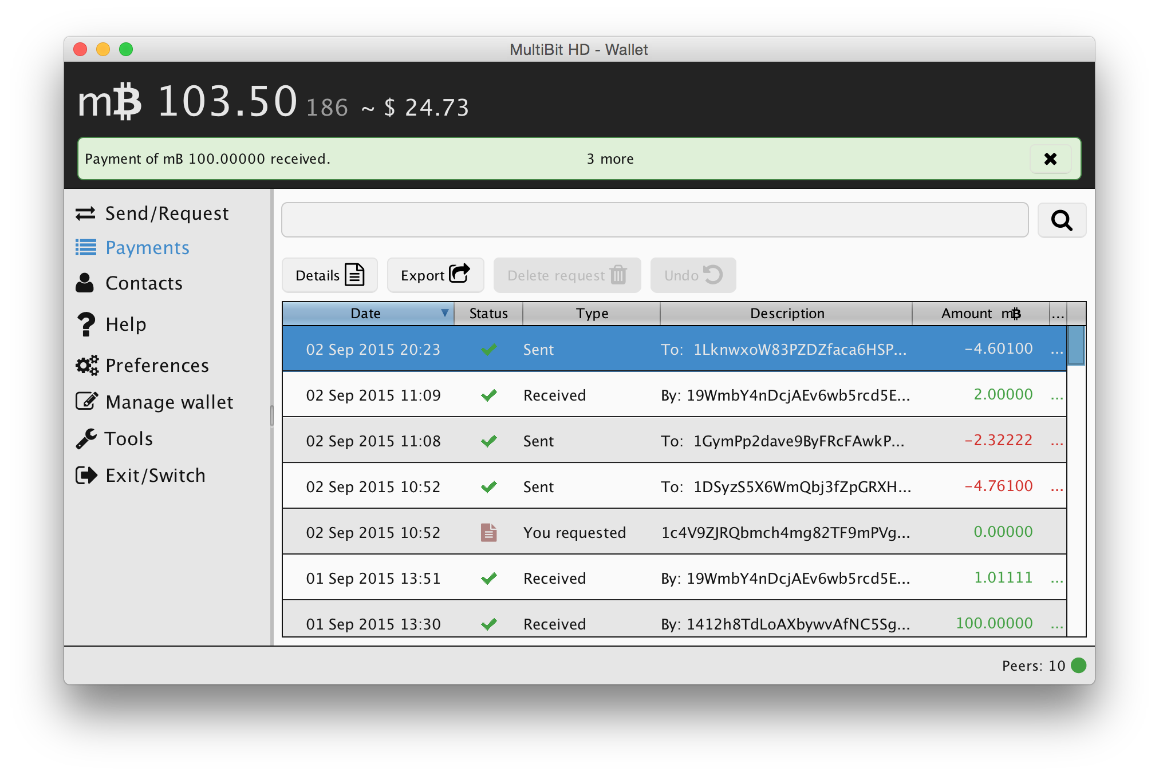
Trusting Software

Slide 7
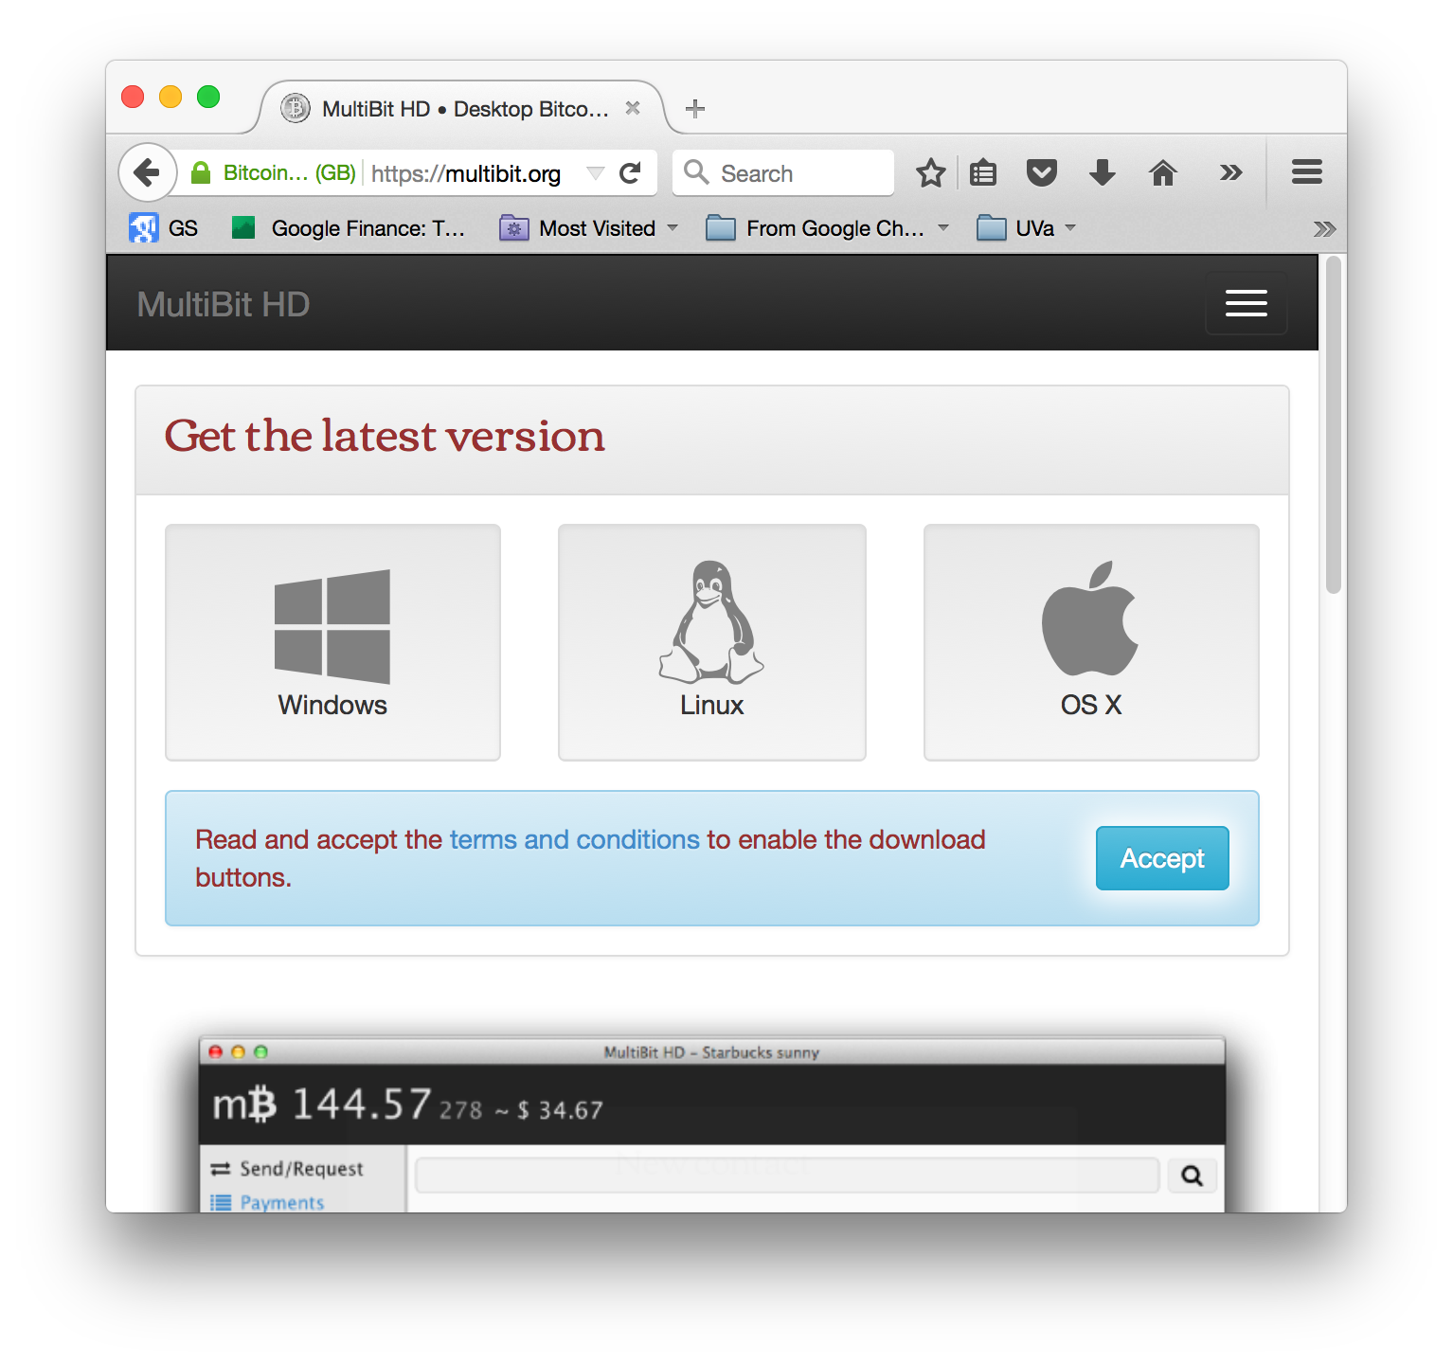
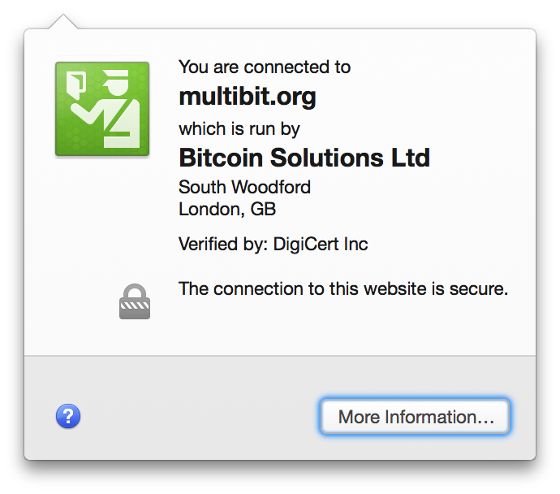

Slide 8
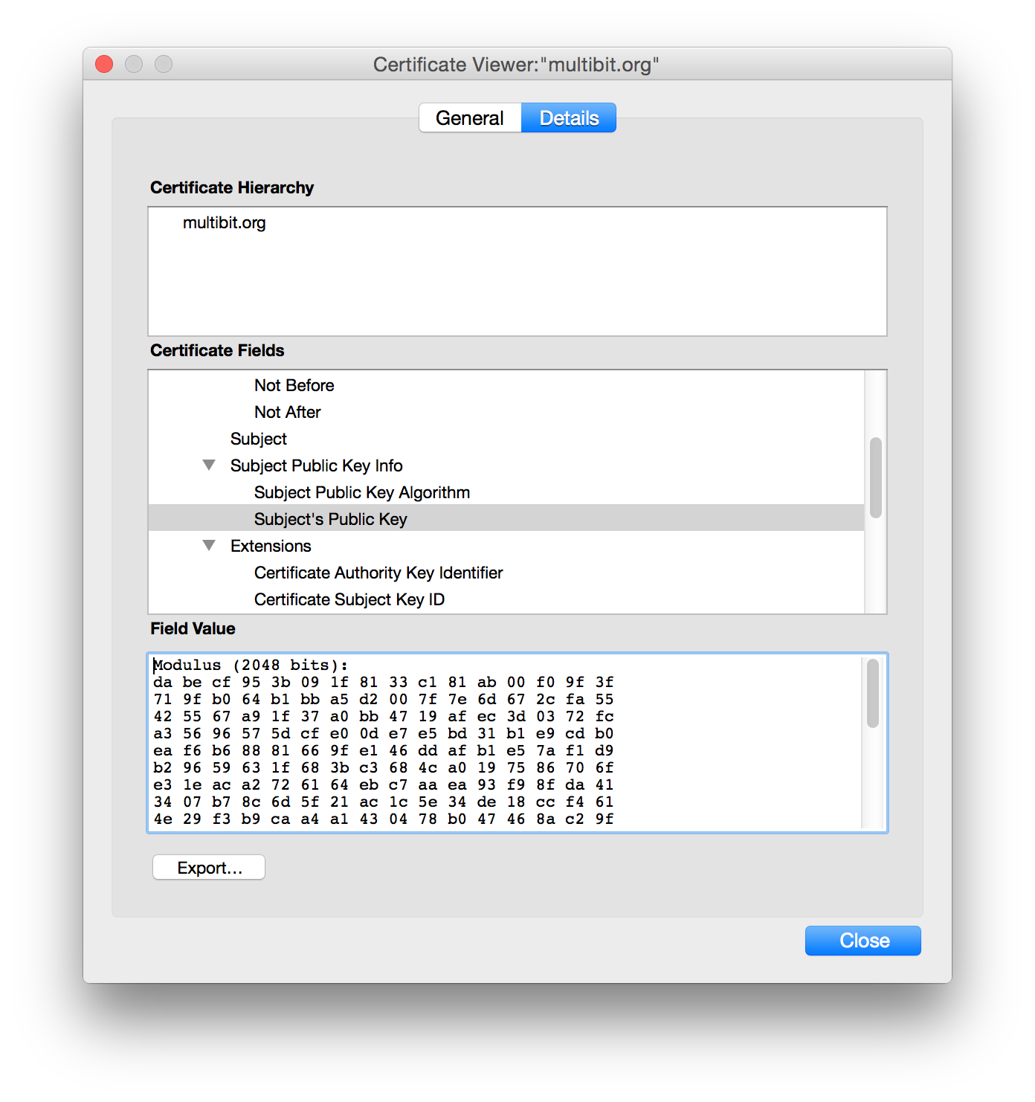

Slide 9
SSL (Secure Sockets Layer)
Client
Server
Hello
Verify Certificate using KU_{CA}
Check identity matches URL
Generate random K
KR_{CA}[Server Identity, KU_{S}]
E_{KUS} (K)
Decryptusing KR_{S}
Secure channel using K
Simplified TLS Handshake Protocol

Slide 10
SSL (Secure Sockets Layer)
Client
Server
Hello
Verify Certificate using KU_{CA}
Check identity matches URL
Generate random K
KR_{CA}[Server Identity, KU_{S}]
How did client get KU_{CA}?
E_{KUS} (K)
Decryptusing KR_{S}
Secure channel using K
Simplified TLS Handshake Protocol

Slide 11
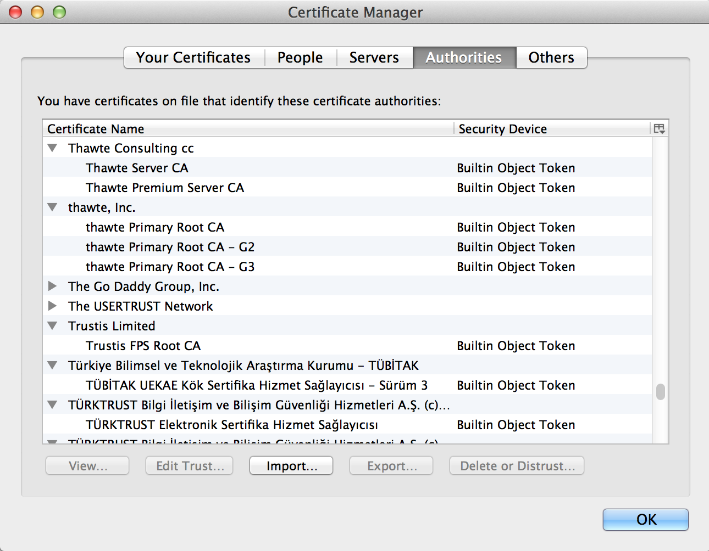

Slide 12
Certificates
How does VarySign decide if it should give certificate to requester?
VarySign.com
multibit.org, KU_{Multibit}
C_{P} = KR_{VarySign}[“multibit.org”, KU_{Multibit}]
TJ
C_{P}
Verifies using KU_{VarySign}
multibit.org

Slide 13
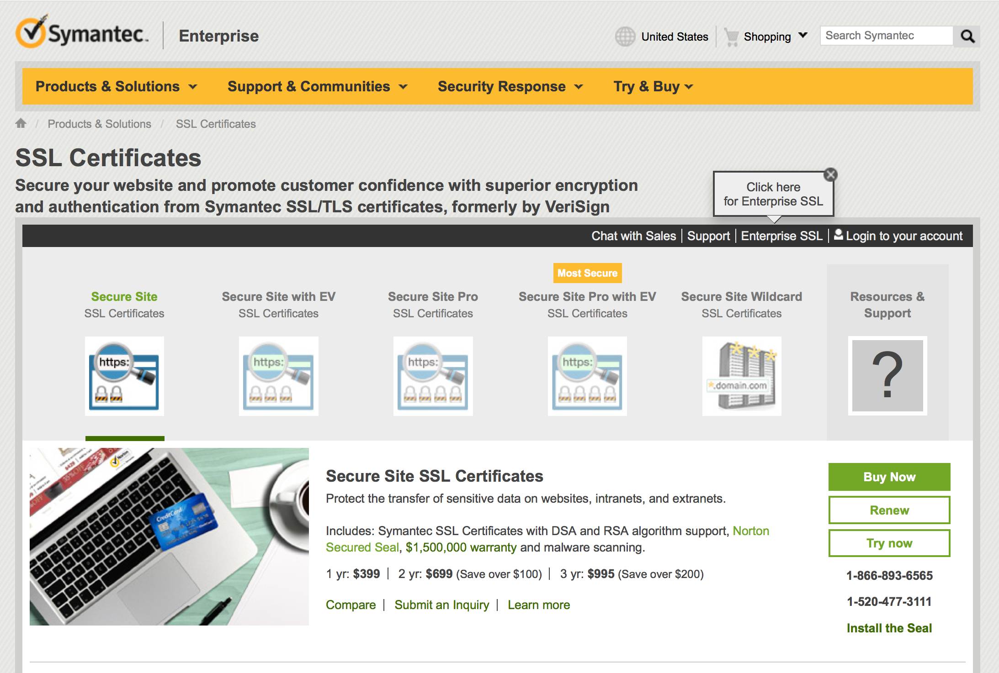

Slide 14
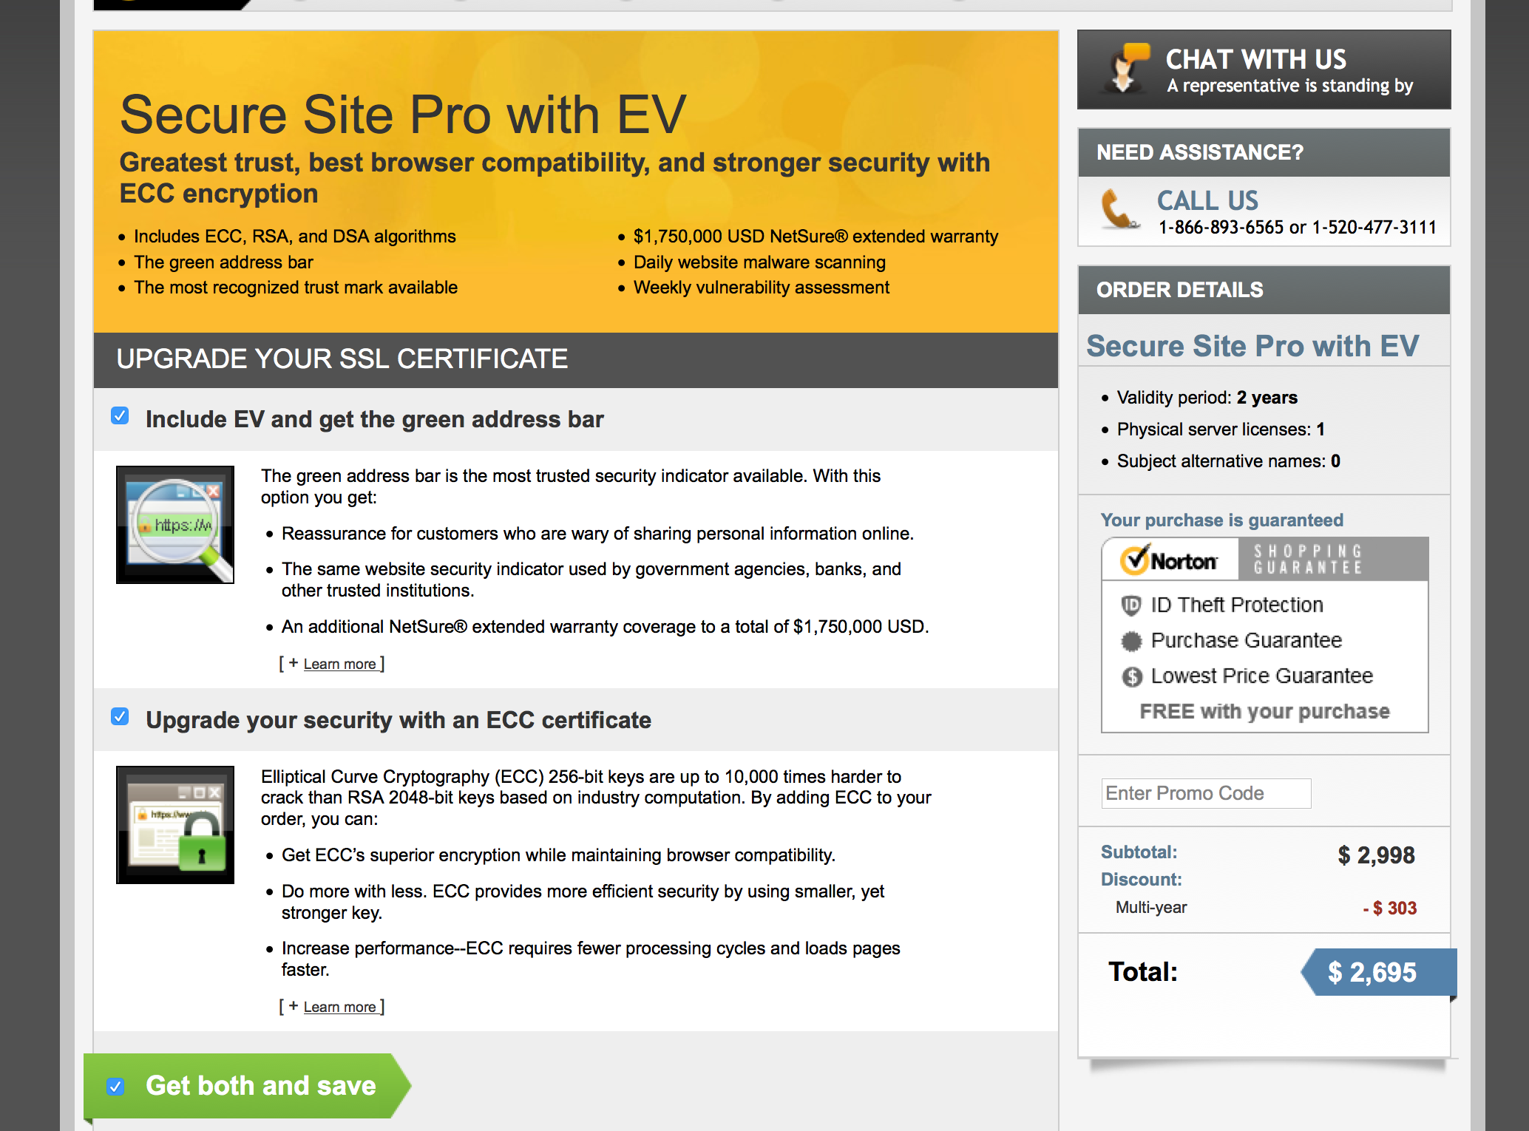

Slide 15
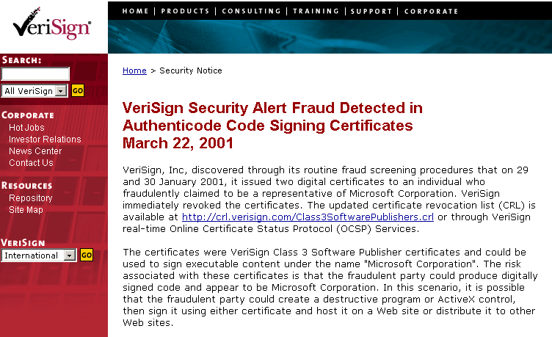
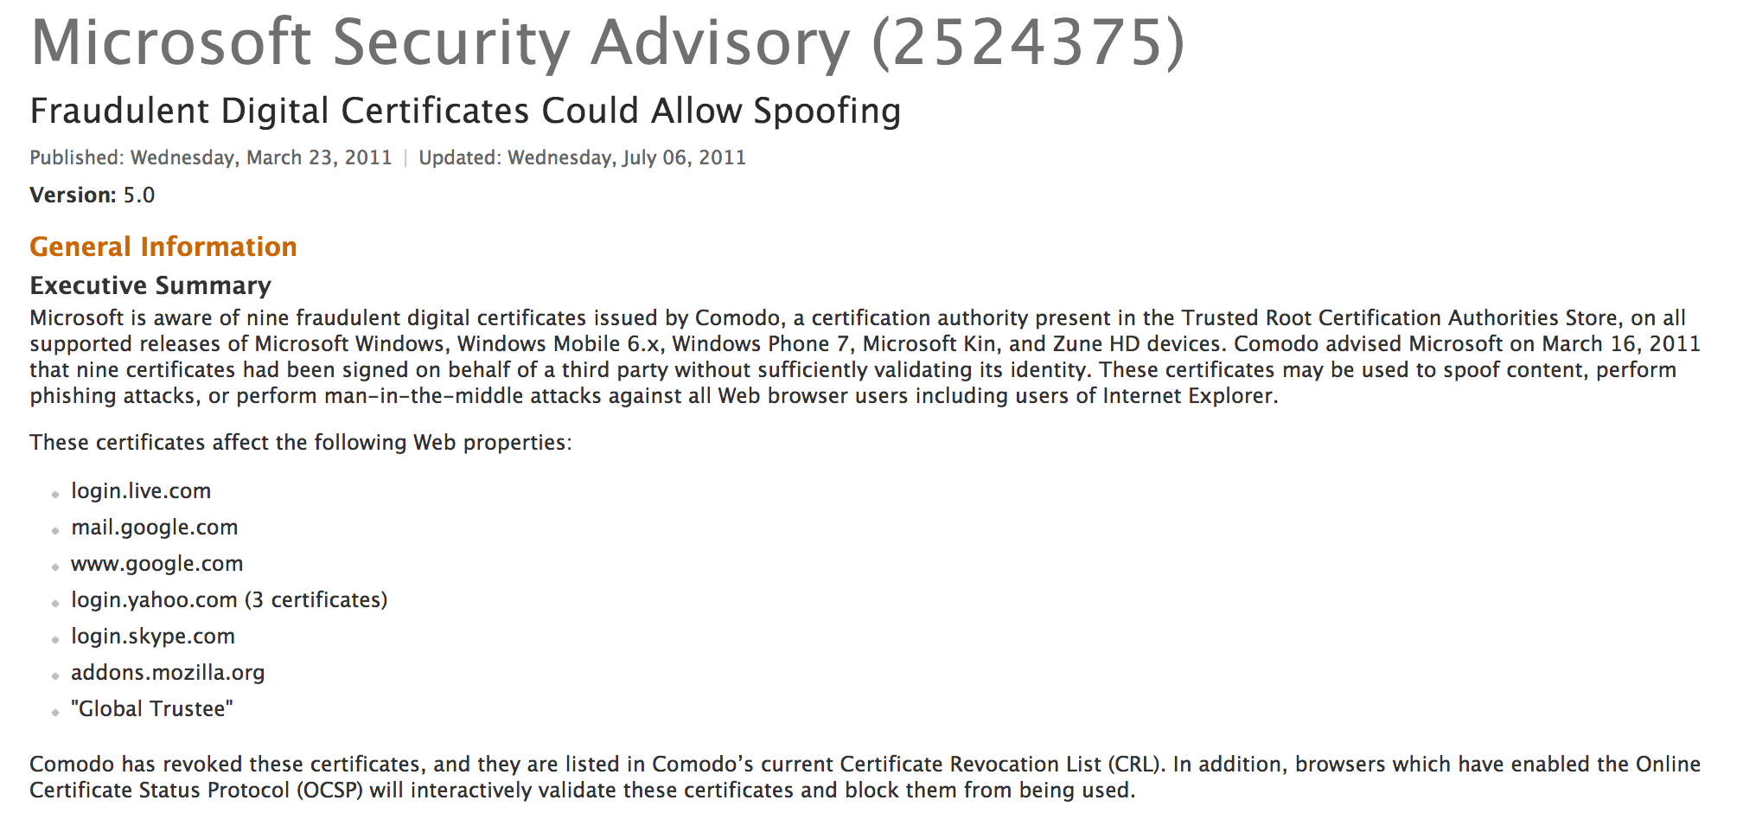
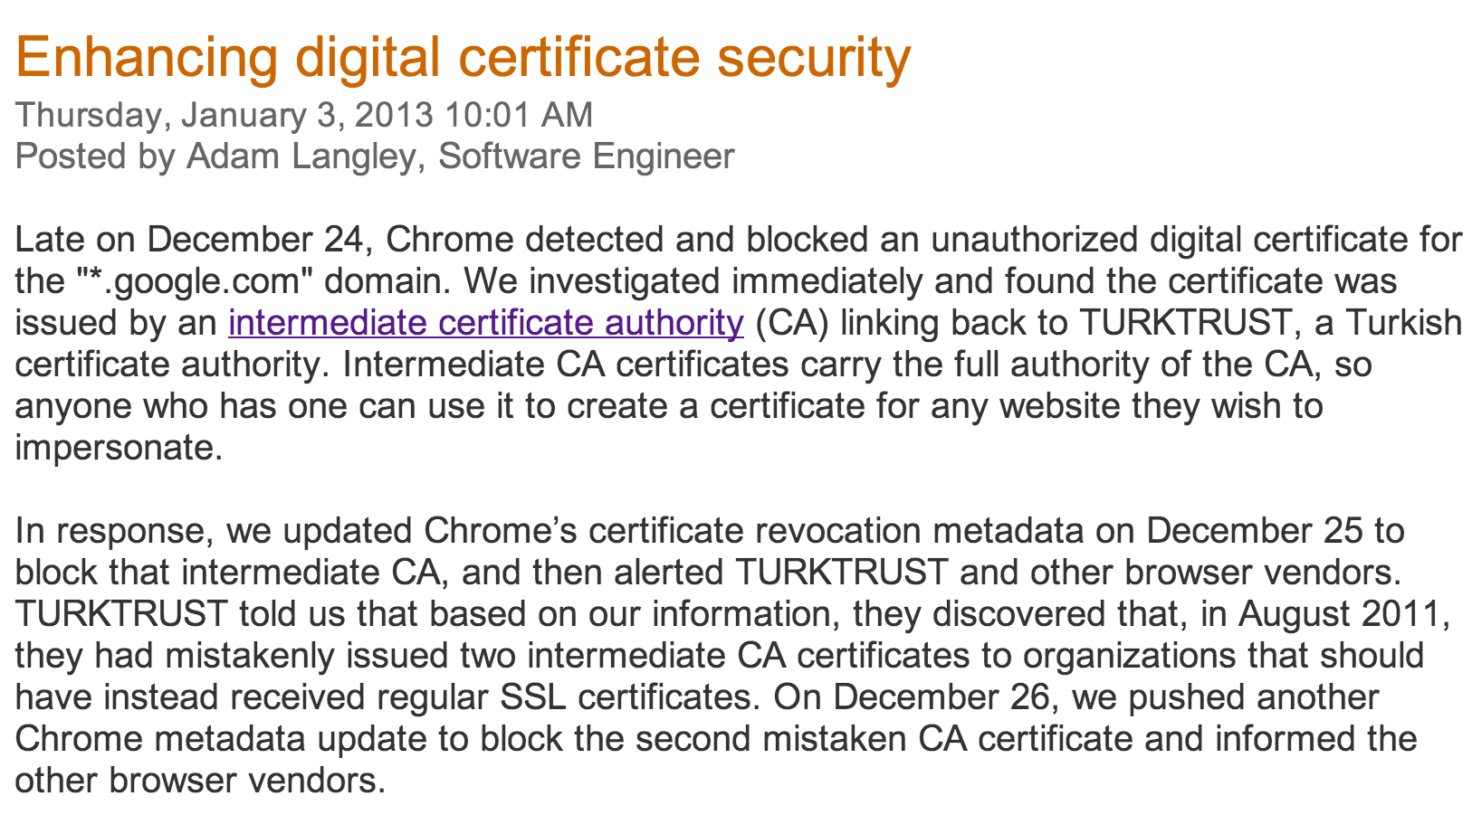

Slide 16
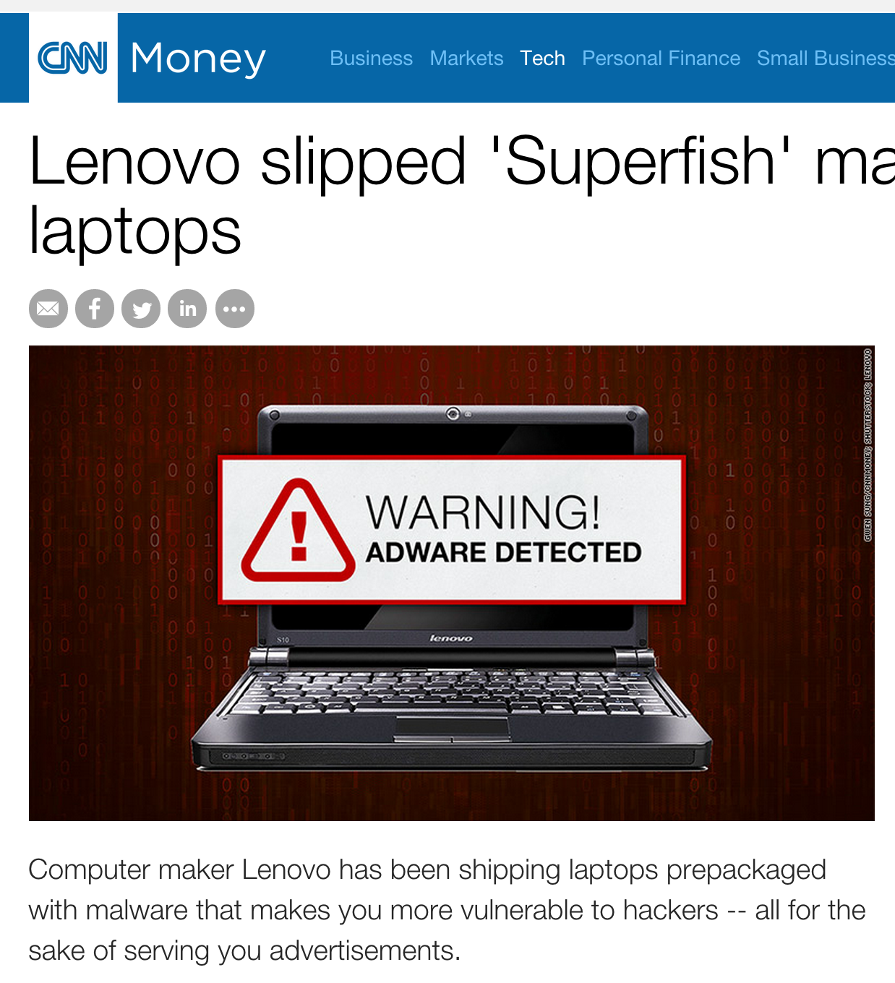
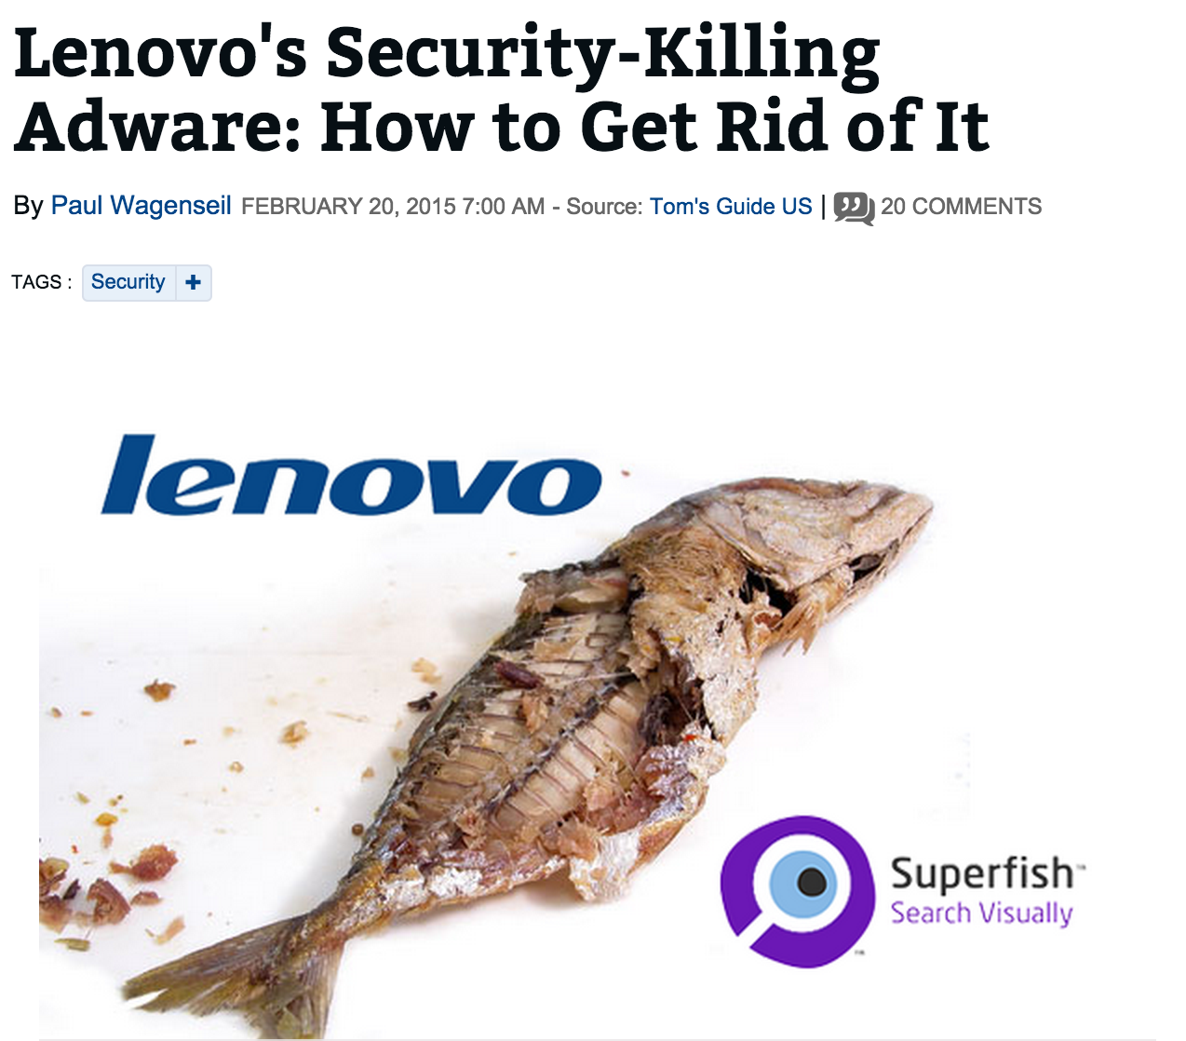
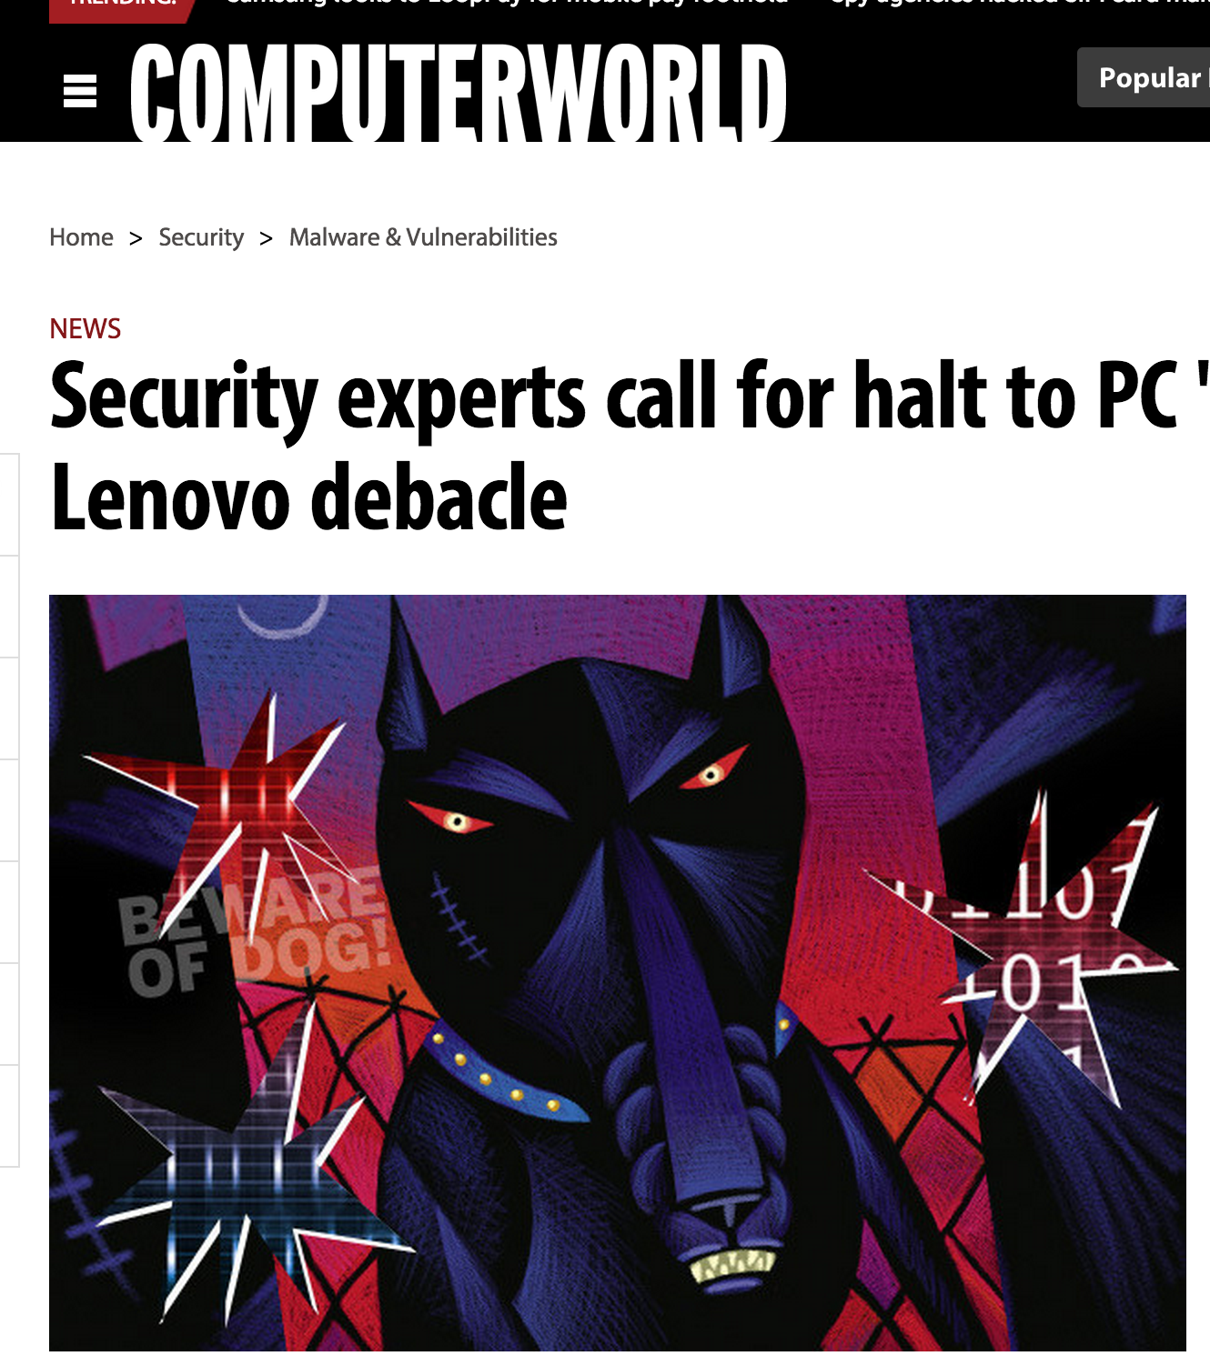

Slide 17
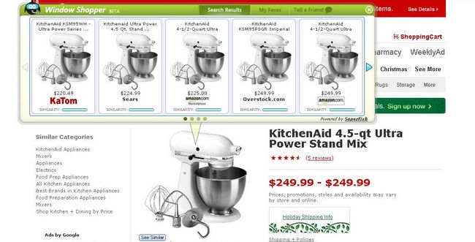
https://www.google.com/#q=chair

Slide 18
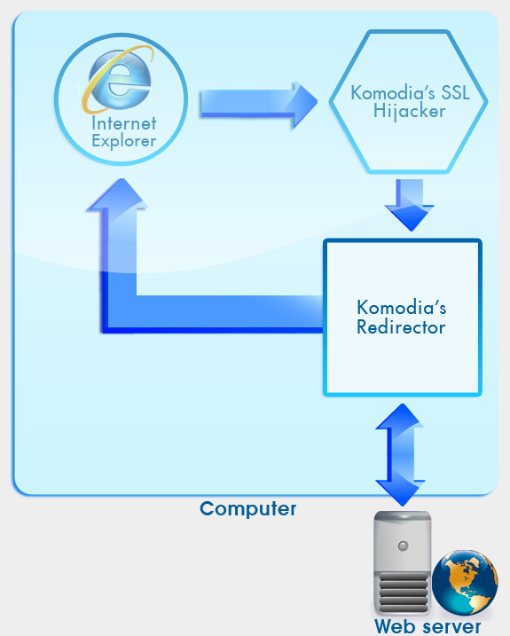
Internet explorer connects to a web server on port 443 using SSL. The data is encrypted.
Komodia’s SSL hijacker intercepts the communication and redirects it to Komodia’s Redirector. The channel between the SSL hijacker and the Redirector is encrypted.
At this stage, Komodia’s Redirector can shape the traffic, block it, or redirect it to another website.
Communication between the Redirector and the website is encrypted using SSL.
All data received from the website can be again modified and/or blocked. When data manipulation is done, it is forwarded again to Internet explorer.
The browser displays the SSL lock, and the session will not display any “Certificate warnings”.
http://www.komodia.com/products/komodias-ssl-decoderdigestor (in archive.org)

Slide 19
Charge
Problem Set 1: due Tuesday
Upcoming office hours:
Now (Samee)
tomorrow (Dave, 2:30-3:30) Monday (Ori, 5-6:30pm)

